Slide 1
Dynamic Programming

Slide 2
What is Dynamic Programming?
Dynamic Programming (DP) is a method to solve complex problems by breaking them into smaller overlapping subproblems.
An algorithm designed with Dynamic Programming divides the problem into subproblems, finds solutions to the subproblems, and puts them together to form a complete solution to the problem we want to solve.

Slide 3
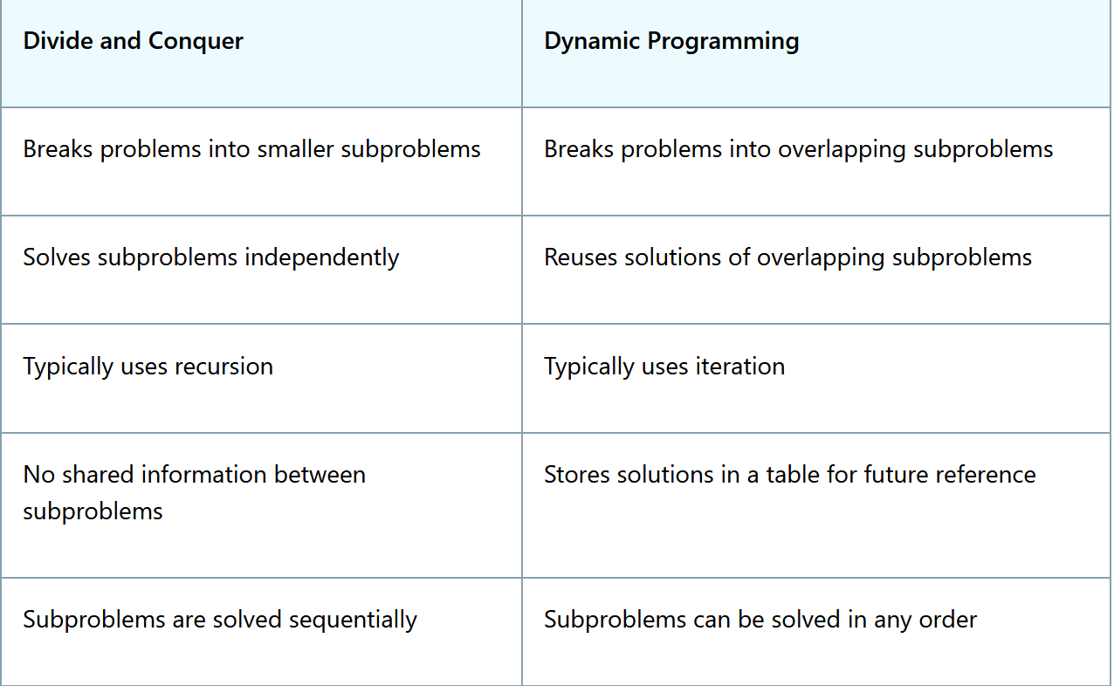

Slide 4
Principle of Optimality
An optimal solution contains optimal solutions to its subproblems.
Also known as Bellman's Principle.
To get the best overall solution:
Each smaller part must also be solved optimally.

Slide 5
Example: 0/1 Knapsack
The 0/1 Knapsack Problem states that you have a backpack with a weight limit, and you are in a room full of treasures, each treasure with a value and a weight.
To solve the 0/1 Knapsack Problem you must figure out which treasures to pack to maximize the total value, and at the same time keeping below the backpack's weight limit.
Optimal profit depends on previous optimal solutions.

Slide 6
A knapsack can carry a maximum weight of 10 kg. Find the maximum profit using 0/1 Knapsack.
Item | Weight | Profit
1 | 2 | 20
2 | 5 | 50
3 | 6 | 60
4 | 3 | 30

Slide 7
GREEDY METHOD
Characteristics of greedy algorithm:
  make a sequence of choices
  each choice is the one that seems best so far, only
depends on what's been done so far
  choice produces a smaller problem to be solved

Slide 8
PHASES OF GREEDY ALGORITHM
A greedy algorithm works in phases.
At each phase:
  takes the best solution right now, without regard for
future consequences
  choosing a local optimum at each step, and end up at a
global optimum solution.

Slide 9
KNAPSACK PROBLEM
There are two version of knapsack problem
0-1 knapsack problem:
  Items are indivisible. (either take an item or not)
  can be solved with dynamic programming.
Fractional knapsack problem:
  Items are divisible. (can take any fraction of an item)
  It can be solved in greedy method

Slide 10
FRACTIONAL KNAPSACK PROBLEM:
The knapsack problem states that − given a set of items, holding weights and profit values, one must determine the subset of the items to be added in a knapsack such that, the total weight of the items must not exceed the limit of the knapsack and its total profit value is maximum.
In fractional knapsack problem the fraction of items can also be added to the knapsack.

Slide 11
Algorithm
Consider all the items with their weights and profits mentioned respectively.
Calculate P_{i}/W_{i} of all the items and sort the items in descending order based on their P_{i}/W_{i} values.
Without exceeding the limit, add the items into the knapsack.
If the knapsack can still store some weight, but the weights of other items exceed the limit, the fractional part of the next time can be added.
Hence, giving it the name fractional knapsack problem.

Slide 12
Problem
For the given set of items and the knapsack capacity of 10 kg, find the subset of the items to be added in the knapsack such that the profit is maximum.
Wi = {3, 3, 2, 5, 1}
Pi = {10, 15, 10, 12, 8}

Slide 13
Breadth-First Search (BFS)
BFS explores a graph level by level.
It first visits all neighbors of a node, then neighbors of neighbors.
Uses a Queue (FIFO).
Algorithm (Steps)
Start from a source node
Mark it as visited
Insert into queue
While queue is not empty:
  Remove node from queue
  Visit all unvisited neighbors
  Mark them visited and add to queue
Complexity
Time: O(V + E)
Space: O(V)

Slide 14
Applications of BFS
🔹 Shortest path in unweighted graph
🔹 Level order traversal in trees
🔹 Finding connected components
🔹 Social networking (friends at distance k)

Slide 15
Depth-First Search (DFS)
DFS explores as deep as possible first, then backtracks.
Uses: Stack (LIFO) OR Recursion
Algorithm (Steps)
Start from source node
Mark it visited
Visit one unvisited neighbor
Repeat until no more neighbors
Backtrack and explore remaining nodes

Slide 16
Applications of DFS
🔹 Cycle detection in graphs
🔹 Topological sorting
🔹 Solving puzzles (maze, Sudoku)
🔹 Connected components
🔹 Path finding
🔹 Detecting strongly connected components

Slide 17
BFS vs DFS
Feature | BFS | DFS
Structure | Queue | Stack / Recursion
Traversal | Level-wise | Depth-wise
Shortest Path | Yes (unweighted) | Not guaranteed
Memory | More | Less
Use Case | Shortest path | Backtracking problems

